Slide 1
Mini Project 1 Dean Stokeld

Slide 2
Context
A private school is looking to increase their student average testing scores and were looking to enroll more students into their school for the new year. Student’s performance is thought to only be influenced by the amount of preparation a student undertakes before an exam as well as general intelligence, however there are other variables that can also have an impact on student’s performance in exams.

Slide 3
Question
Can features such as gender, parent’s level of education, parental income (lunch) and prior student preparation (study) be used to predict a student’s performance in exams?

Slide 4
Data Pipeline
Data Acquisition
Data Exploration
Data Visualisation
Hypothesis Testing
Summary

Slide 5
Dataset
Source: Royce Kimmons – Generated exam scores for students at a public school
Gender, parental level of education, parental income (lunch) preparation, math/reading/writing score.

Slide 6
Exploratory Data Analysis

Slide 7
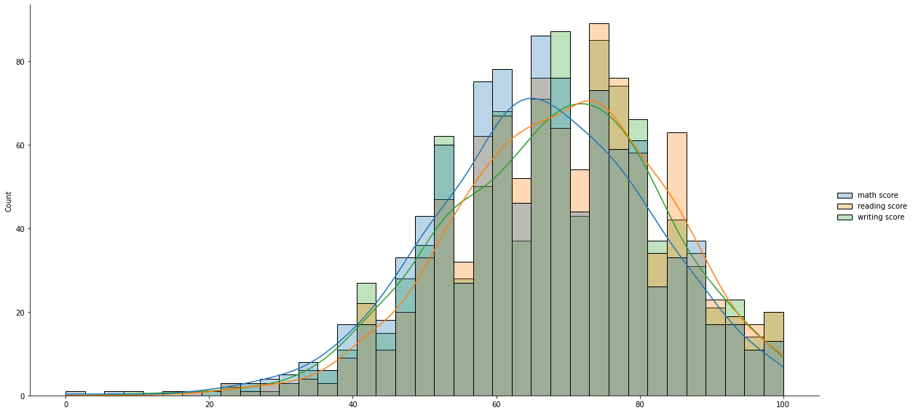
Distributions of exam scores

Slide 8
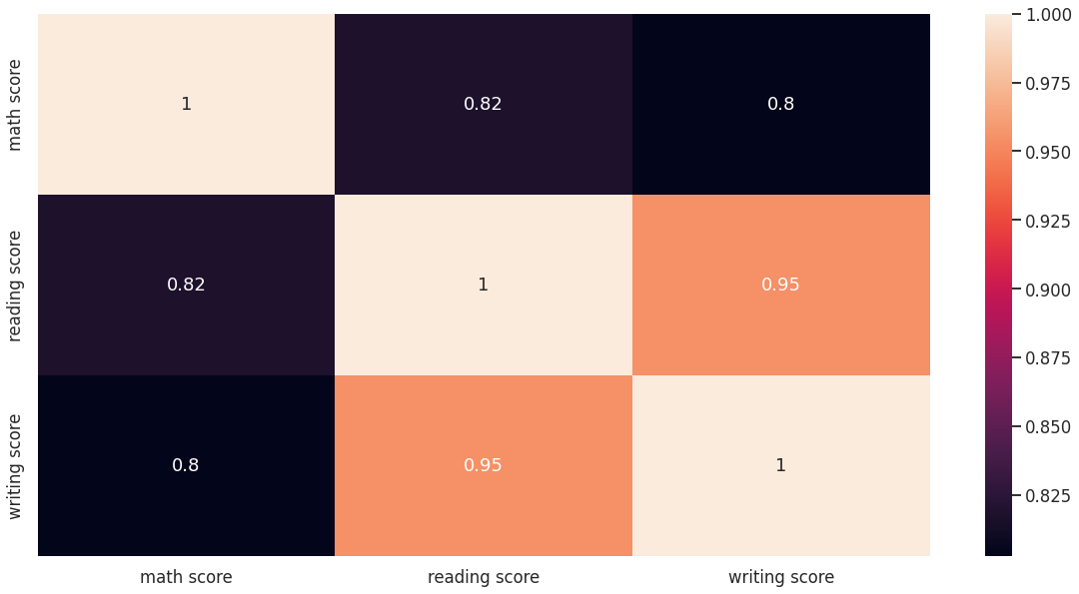
Correlation

Slide 9
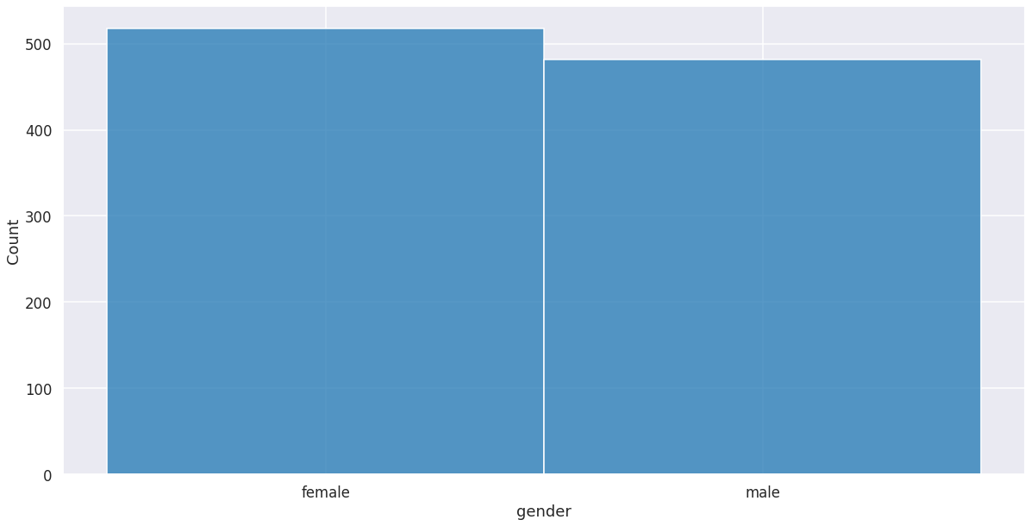
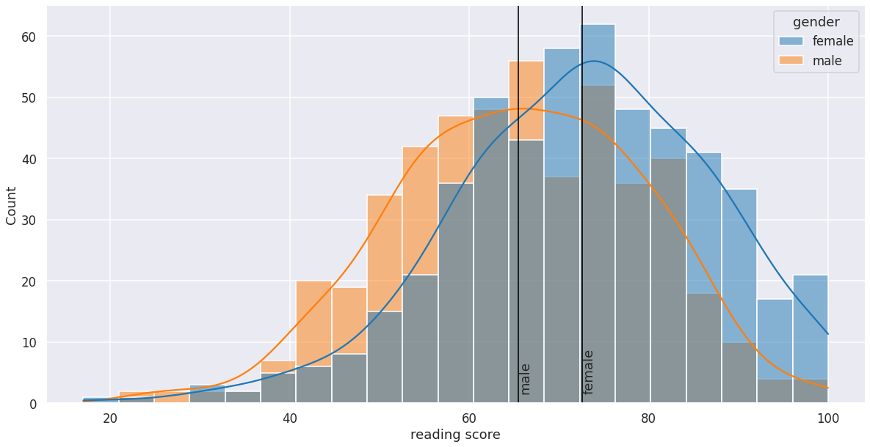
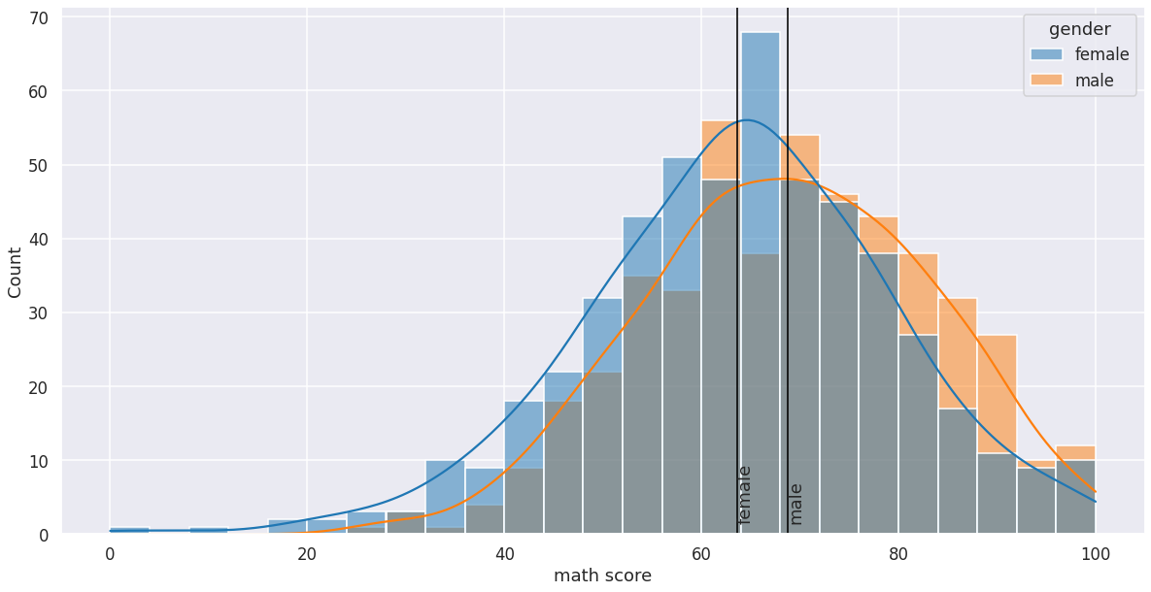
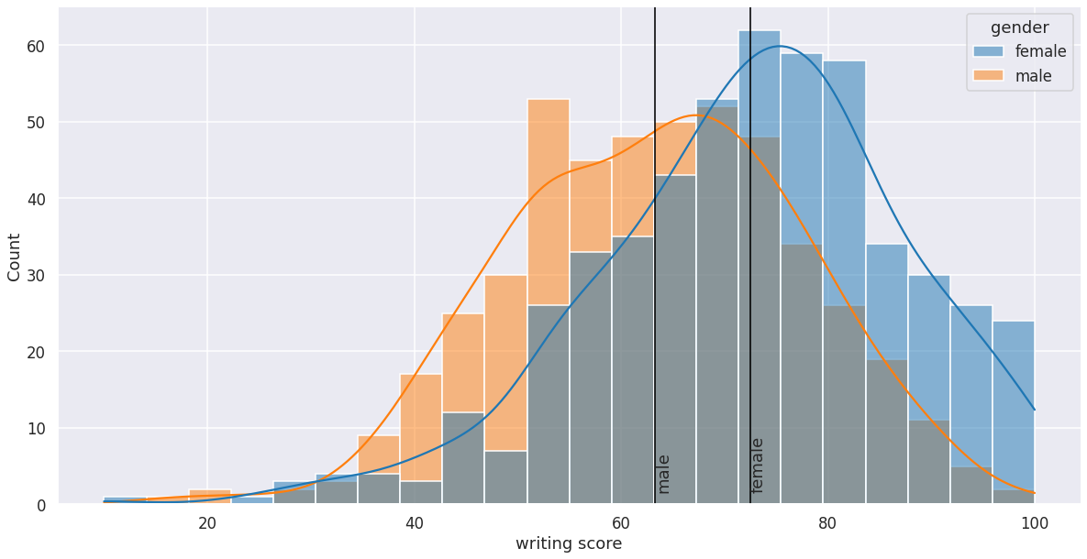
Scores based on gender

Slide 10
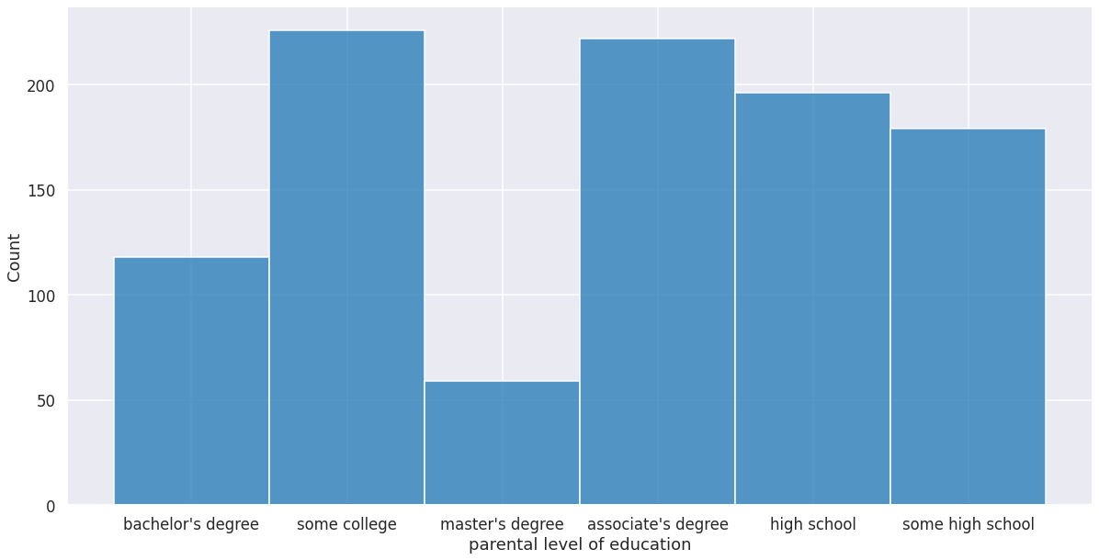
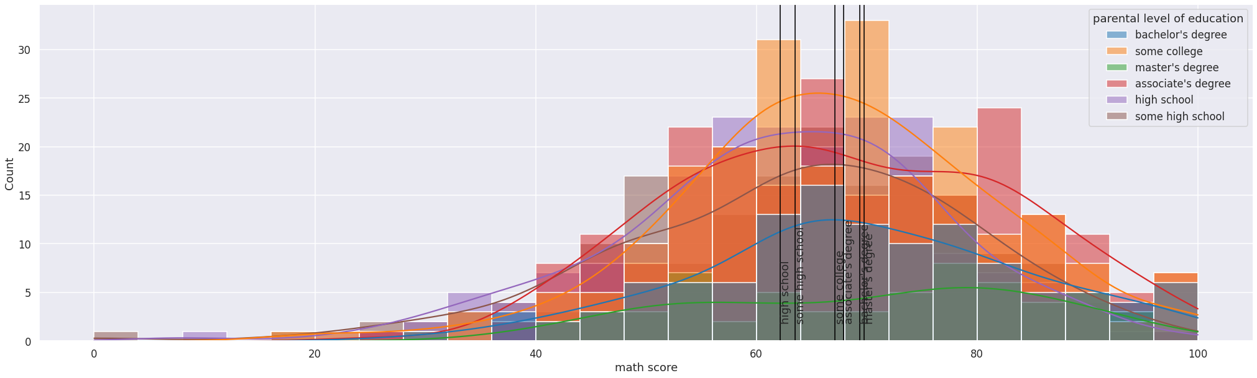
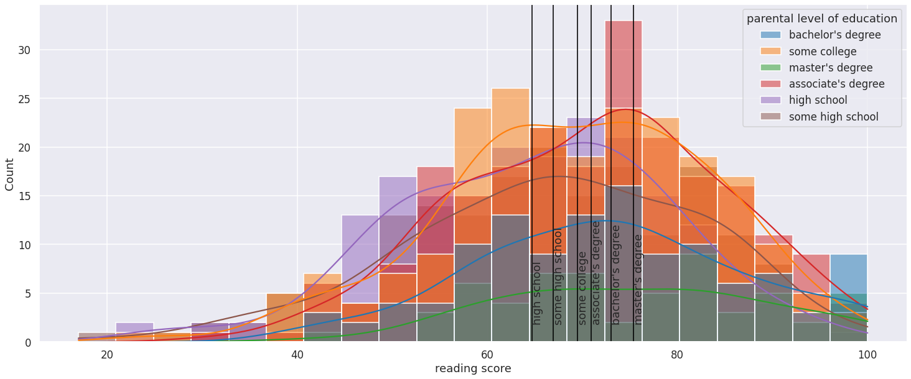
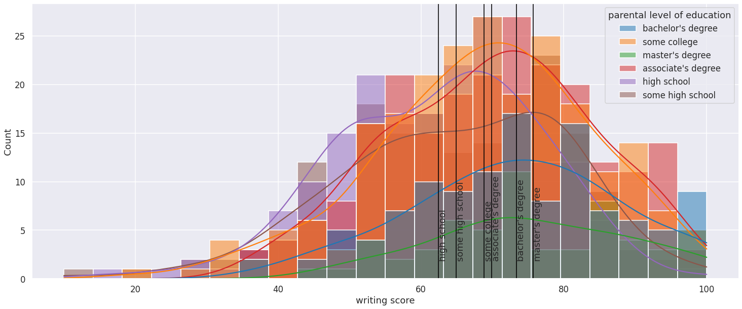
Parental Level of Education

Slide 11
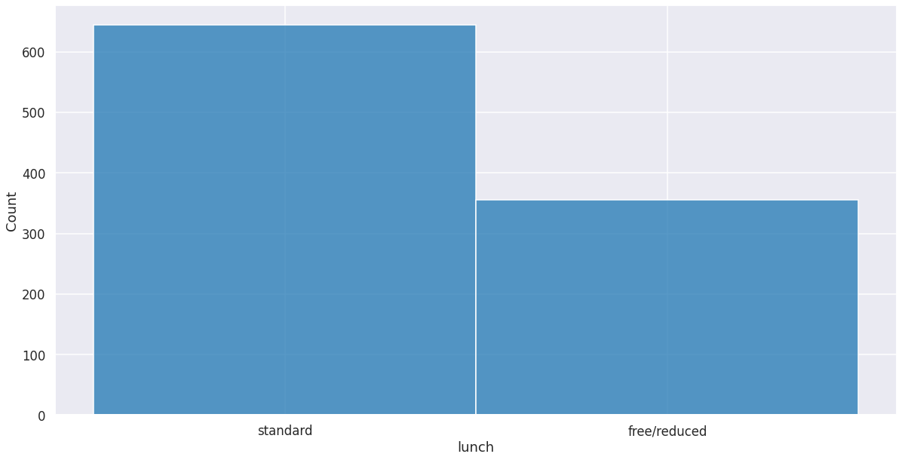
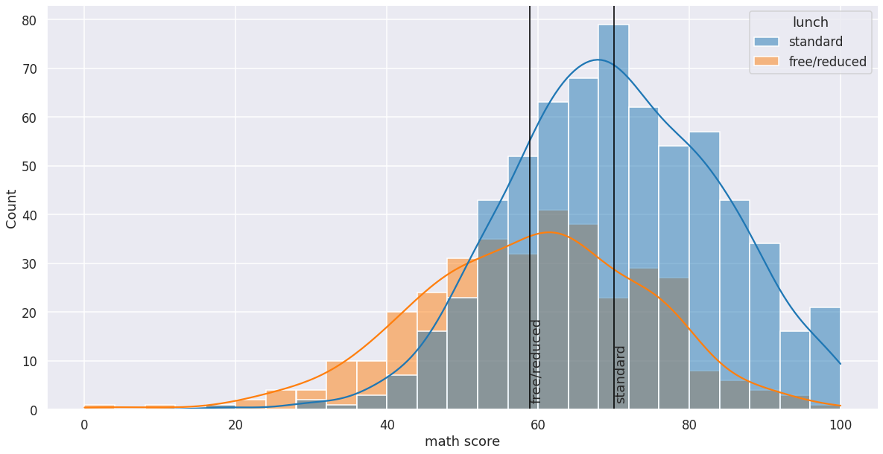
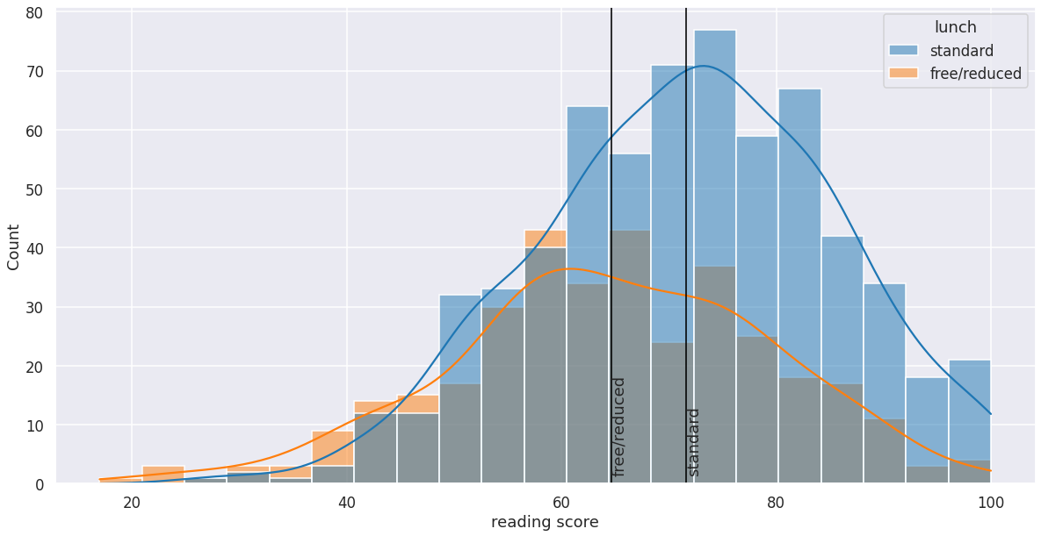
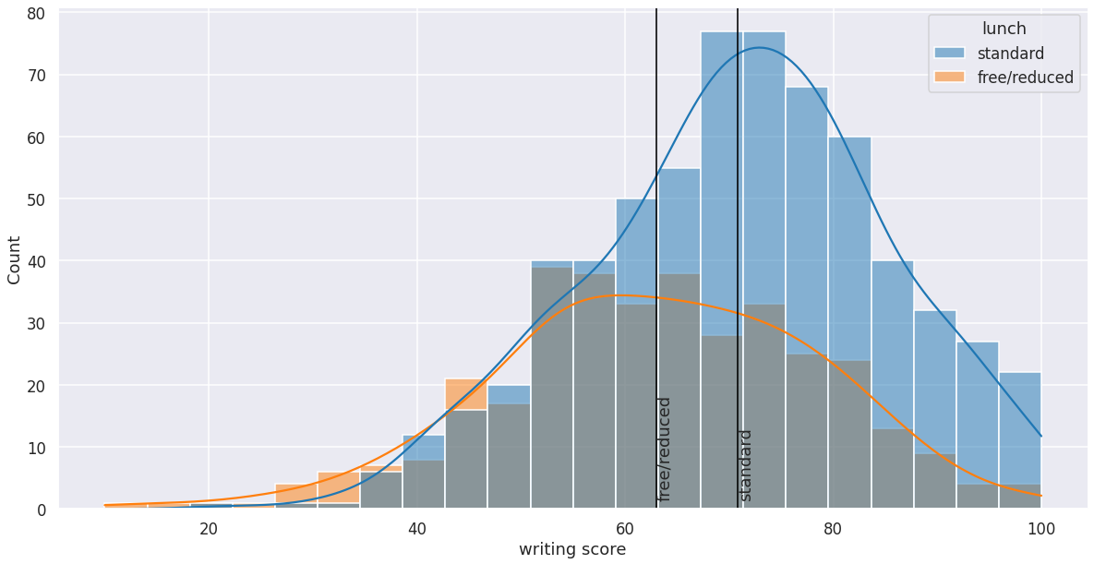
Parental Income (observed through lunch expense)

Slide 12
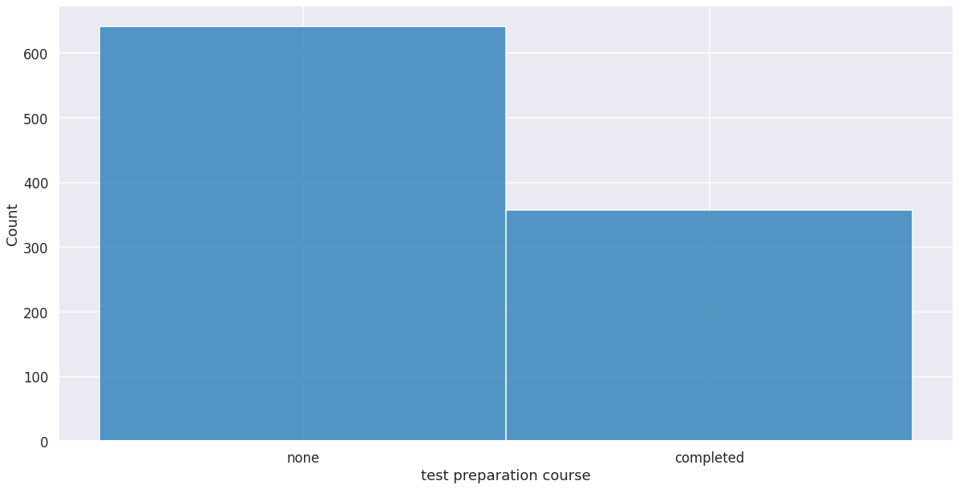
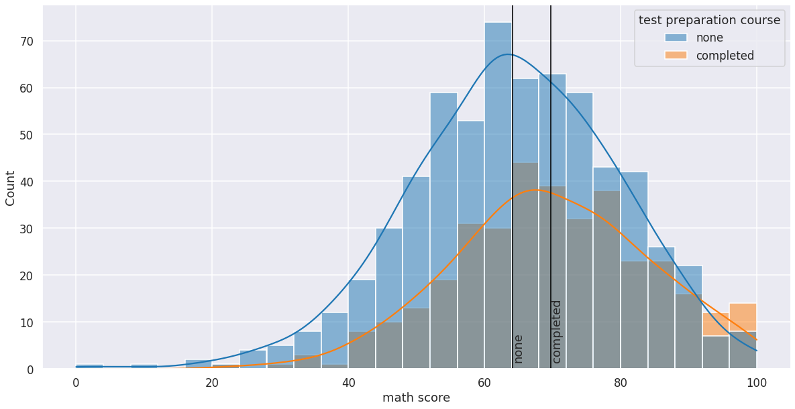
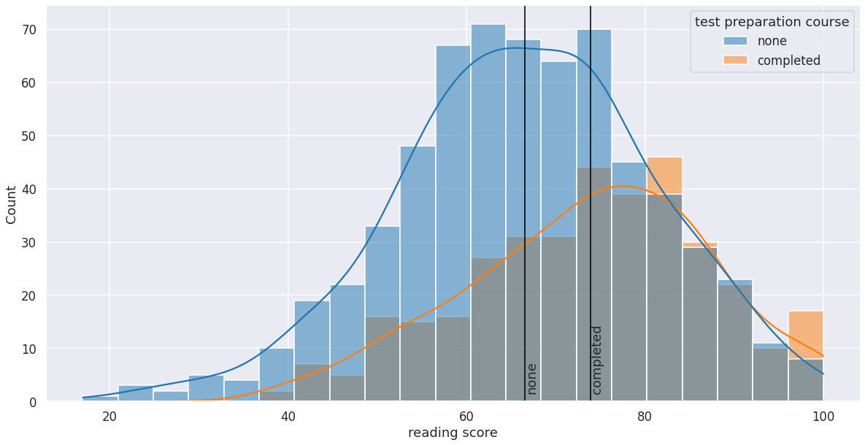
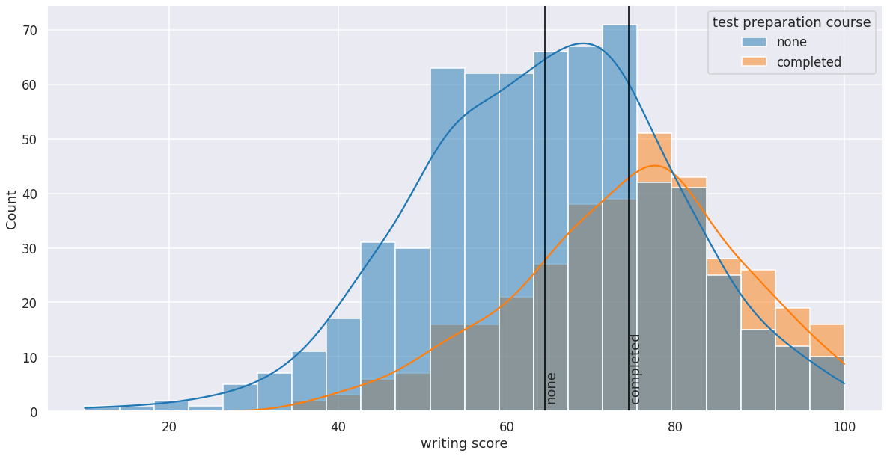
Student preparation

Slide 13
Hypothesis Testing
H0: The observed features have no impact on a student’s performance in exams.
H1: The observed features have a statistically significant impact on a student’s performance in exams.
Conclusion: Reject the null hypothesis. The features has a statistically significant impact on student’s performance in exams.

Slide 14
Summary & Next Steps
In summary, all observed features are positively correlated to the outcome of student’s performance in exams.
Gender: Males are better at math while females are better at reading and writing.
Parental income: There is positive correlation with higher scores in all three subjects.
Parental education: Lower levels of education are negatively correlated with scores while parents with higher levels of education have a higher chance of achieving higher scores.
Student preparation: Preparing for exams prior to the exam has a positive correlation with receiving higher exam scores.
Therefore, a student’s performance in exams can be predicted using the set of observed features.
Next steps: Further analysis is required to create a model to predict student’s performance in exams using a set of existing features.

